Slide 1


Widely Used Image Formats
Full-Stack Web Development Bootcamp

Slide 2




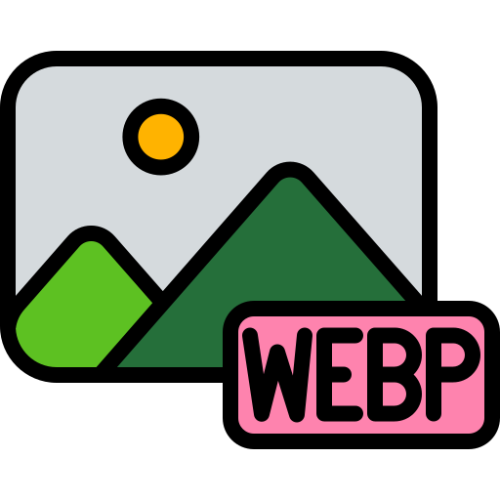
Types Of Images
Commonly Used Image Formats
A computer is an electronic device that processes data, executes instructions, and performs tasks through hardware and software to solve problems and automate operations.

Slide 3
Understanding The JPEG/JPG Format
Lossy Compression: Reduces file size by discarding some image data, suitable for photos.
Small File Size: Efficiently balances quality and file size, ideal for web use.
16.7 Million Colors: Supports millions of colors, making it great for detailed images.
Opaque Images: Does not support transparency, unlike PNG.
Universal Support: Supported by all web browsers and image software.
Does Not Support Transparency

Slide 4
Understanding The PNG Format
Lossless Compression: Retains all image data, maintaining high quality without losing detail.
Supports Transparency: Allows images to have transparent backgrounds, useful for logos and icons.
Supports 24-bit Color: Offers up to 16.7 million colors, ideal for detailed images.
Larger File Size: Generally larger than JPEG due to lossless compression, but maintains quality.
Widely Supported: Supported by all modern web browsers and image editing software.
Supports Transparency

Slide 5
Understanding The SVG Format
Infinite Scalability: Vector-based, scales without losing quality, perfect for logos and icons.
Small File Size: Lightweight files, often smaller than raster images at high resolutions.
Easily Editable: Can be modified with code or graphic editors, ideal for web design.
Supports Transparency: Allows transparent backgrounds, useful for layered designs.
Broad Support: Supported by modern web browsers and design software, versatile for web use.
Used For Vector Graphics

Slide 6
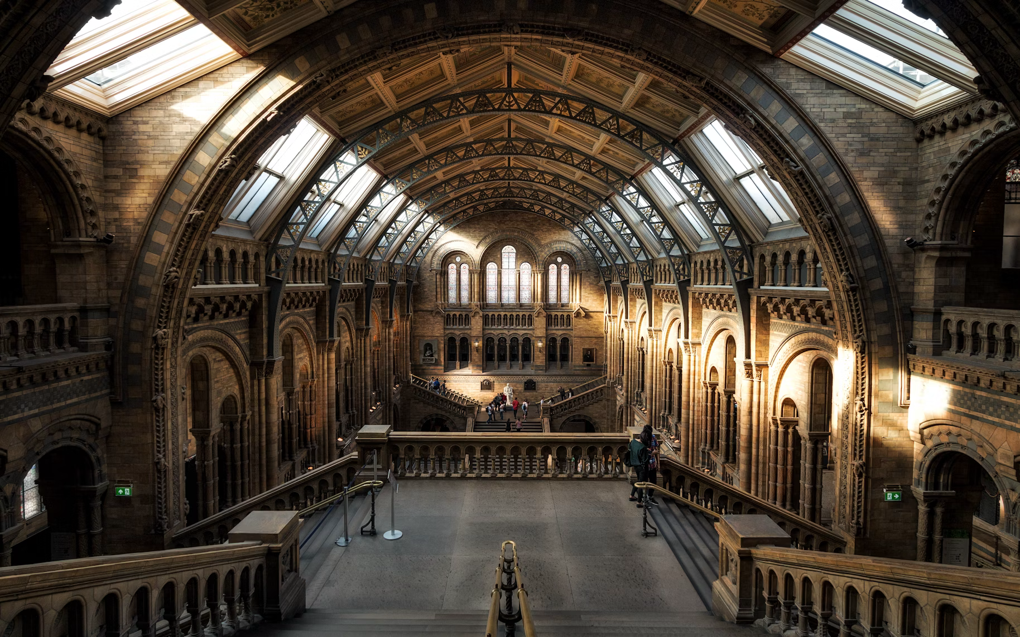
Raster Vs. Vector Images
Vector
Raster
Notes:
The main difference is that vector images are made of paths and can be scaled infinitely without losing quality, while raster images (like JPEG, PNG) are made of pixels and lose clarity when resized.

Slide 7
Understanding The WebP Format
Lossy and Lossless: Supports both lossy and lossless compression, offering flexibility in balancing quality and file size.
Supports Transparency: Allows for transparent backgrounds, useful in web design, similar to PNG.
Supports 24-bit Color: Handles millions of colors, maintaining image quality.
Smaller File Size: Typically produces smaller files than JPEG or PNG, reducing load times.
Broad Support: Increasingly supported by modern browsers, though not yet universal.

